Slide 1

Stack Overflow Survey Data Analytics
Capstone Project
Name: Punyaja Mishra
Date: February 05, 2025

Slide 2



OUTLINE
Executive Summary
Introduction
Methodology
Results
Visualization – Charts
Dashboard
Discussion
Findings & Implications
Conclusion
Appendix

Slide 3

EXECUTIVE SUMMARY
Data:
Stack Overflow Survey Worldwide Dataset
Objective:
Gain insights into the developer community
Explore coding activities, tech trends, demographics and employment distribution
Challenges:
Pre-processed and filtered for consistency, with tasks like handling missing values, duplicates, and normalization being crucial for accurate analysis
Several data issues encountered such as multiple values per field, missing data and duplicates
Stakeholders:
Stack overflow Team & Users
Support decision-making and platform enhancements

Slide 4
EXECUTIVE SUMMARY
Tools and Methods:
Multiple platforms, tools and programming languages like Jupyter Lab, python, SQL, IBM Cognos and Excel
Data Wrangling, Visualization and dashboard creation
Key findings:
Identified significant trends in developer preferences, including the most popular programming languages, coding activities, and employment types
Outcome:
Interactive dashboards and better insights into today’s technological trends

Slide 5

INTRODUCTION
Problem: Complex Stack Overflow Developer Survey Dataset with messy data
Objective: Analyze developer demographics, coding activities, tech preferences, and employment trends.
Significance: Insights will inform decision-making for business, educators and developers
Scope: Responses from global developers covering various technologies and career aspects
Approach: Data cleaning, exploratory analysis, and interactive visualizations for insights

Slide 6

METHODOLOGY
Data Collection:
Utilized publicly accessible Stack Overflow API for data gathering
Sample Size:
Worldwide data of 60,000+ responses with 100+ attributes
Data Cleaning:
Handling Missing Values: Replaced missing values with mean (mean imputation method)
Normalization: Applied techniques to scale numeric data to ensure consistency
Data Splitting: Addressed multiple values per field by splitting values into separate records

Slide 7
METHODOLOGY
Analysis Tools:
Jupyter Lab: Data exploring and analysis
Python: Data Wrangling, analysis and visualization
Excel: Used for data cleaning and preprocessing
IBM Cognos: For dashboard creation and reporting
Visualization Techniques:
Multiple charts used such as bar charts, column charts, aps, tree maps, hierarchy packed bubble chart and word clouds

Slide 8
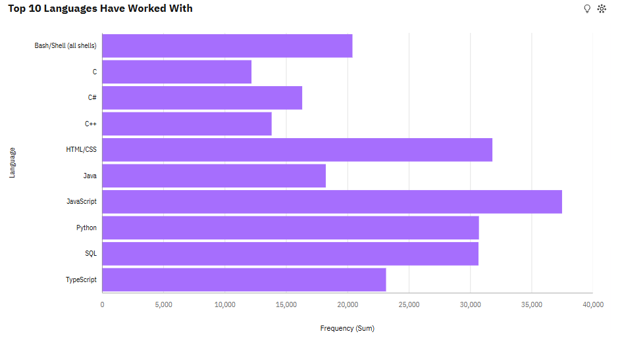
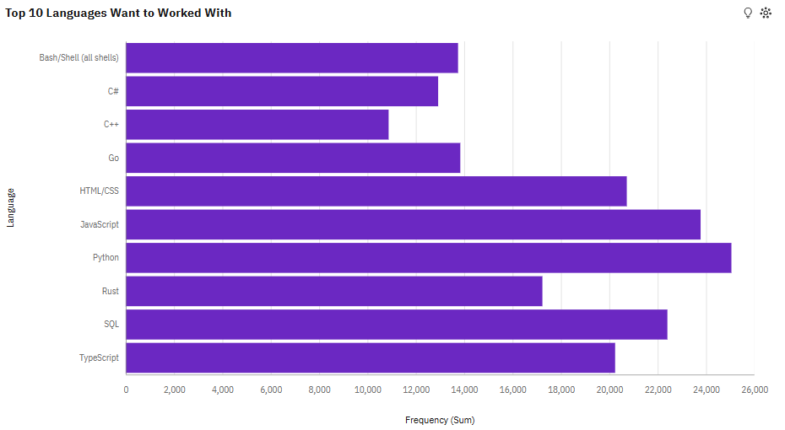
PROGRAMMING LANGUAGE TRENDS
Current Year
Next Year

Slide 9
TOP 10 PROGRAMMING LANGUAGE TRENDS - FINDINGS & IMPLICATIONS
FINDINGS | IMPLICATIONS
Most popular programming language: PYTHON | High demand for Python indicates a focus on data science and AI in the developer community
Low-frequency languages: C, Java | Less popularity in these languages suggests limited developer interest in these languages
Languages gaining traction: Go, Rust | The rise of niche languages reflects emerging trends in specialized development fields

Slide 10
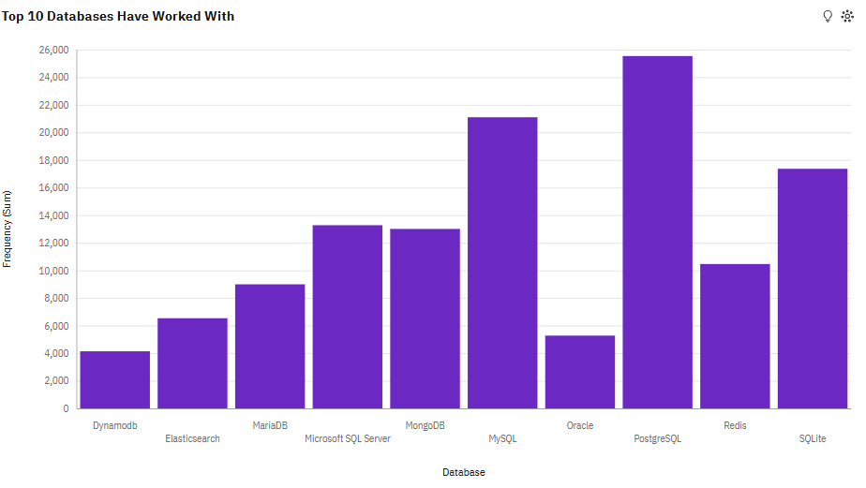
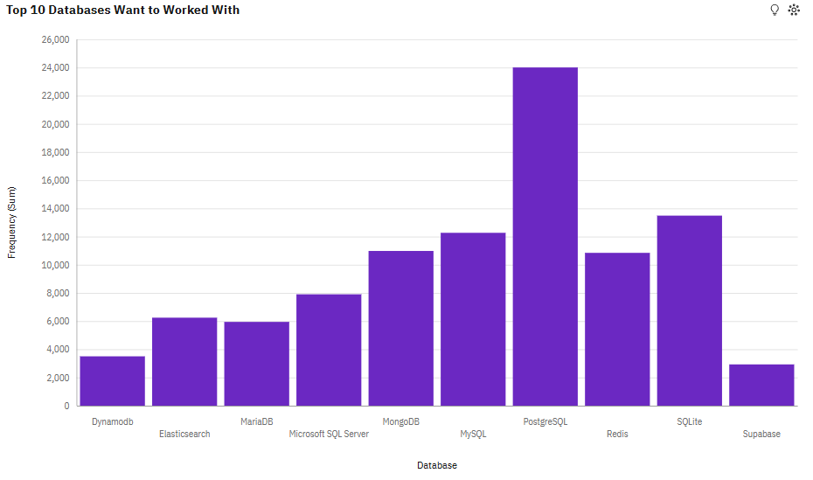
DATABASE TRENDS
Current Year
Next Year

Slide 11
TOP 10 DATABASE TRENDS - FINDINGS & IMPLICATIONS
FINDINGS | IMPLICATIONS
Most popular Database: PostgreSQL | High demand for PostgreSQL both in current and future trend signifies strong demand for open-source, relational databases that offer flexibility and scalability
Low-frequency languages: Oracle | Oracle’s low adoption reflects a trend away from older, enterprise-driven db solutions in favor of more modern, cost-effective alternatives
Languages gaining traction: MongoDB, Supabase | The rise of MongoDB and Supabase highlights the increasing focus on NoSQL and cloud-native db to support web-applications and real time processing

Slide 12

DASHBOARDS

Slide 13
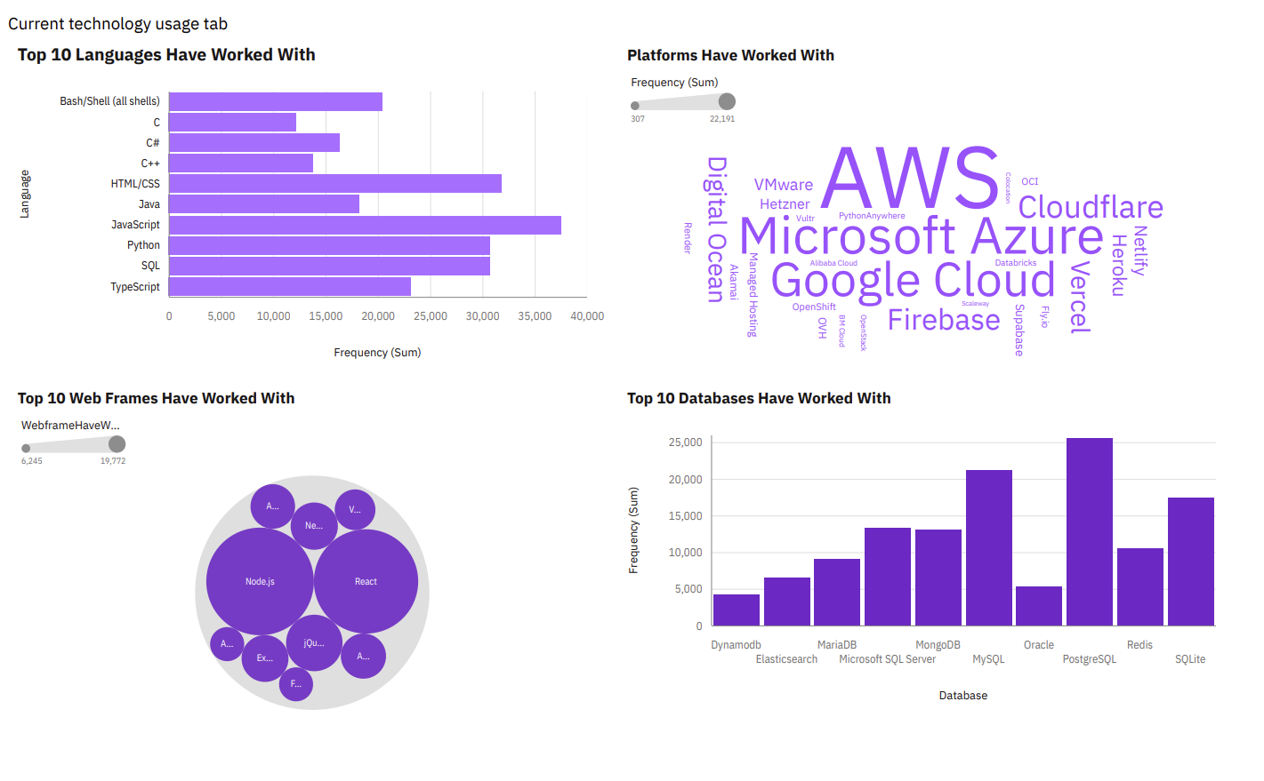
CURRENT TECHNOLOGY USAGE TAB

Slide 14
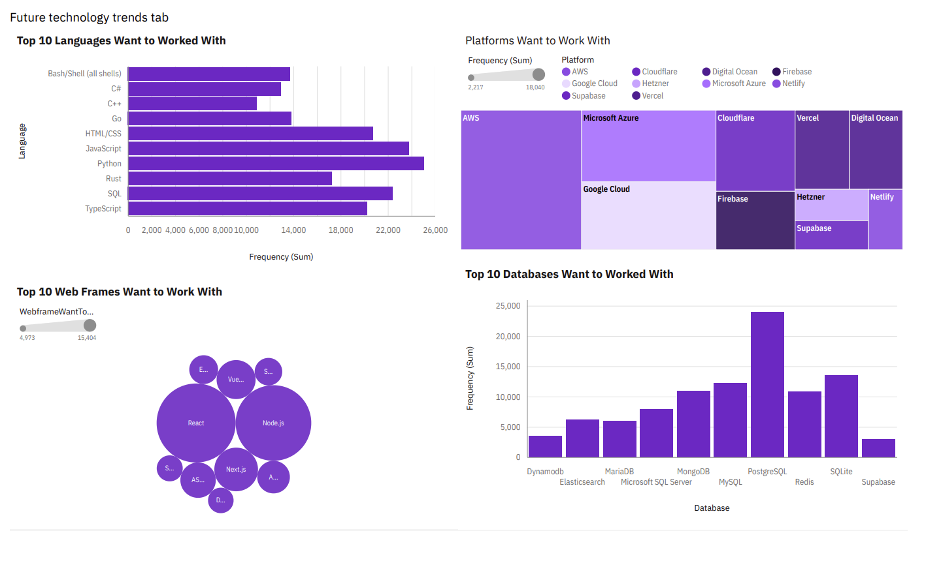
FUTURE TECHNOLOGY USAGE TAB

Slide 15
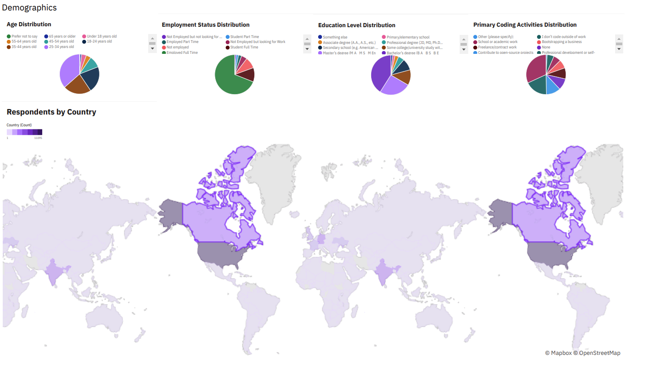
DEMOGRAPHICS VISUALIZATION

Slide 16
DISCUSSIONS – KEY INSIGHTS FROM DASHBOARDS
Cloud Platforms & Databases
AWS, Microsoft Azure, and Google Cloud are the most used platforms and also the most desired ones. Supabase is emerging as a preferred technology in both databases and platforms
Web Framework Trends
React and Node.js dominate both current usage and future interest. Django, Svelte, and Spring Boot are gaining traction, while jQuery and Flask are declining in popularity
Developer Demographics
Most survey respondents are from the US, Canada, India, Germany, and Ukraine, with lower representation from other regions like France and the UK.
Age & Education
The majority of developers fall within the 25-34 age group, followed by 35-44, with most holding a bachelor's degree, then master's, some college, and secondary education.
Employment & Coding Activities
Most respondents are full-time employed developers, followed by students and those not employed. Many engage in coding for hobbies, professional development, and open-source contributions.

Slide 17
OVERALL FINDINGS & IMPLICATIONS
AREA | FINDINGS | IMPLICATIONS
Platforms & Databases | AWS, Microsoft Azure and Google Cloud are the most used and most desired1 | Cloud computing remains dominant, with developers focusing on multi-cloud expertise
Emerging Platforms | Supabase is gaining interest in both database and platform trends. | Rising demand for open-source and scalable cloud solutions.
Web Frameworks | React and Node.js are the most used and most wanted frameworks. | Full-stack JavaScript remains the industry standard for modern web development.
Future Web Frameworks | Django, Svelte, and Spring Boot are gaining traction, while jQuery and Flask see less interest. | A shift towards modern, scalable frameworks and reduced reliance on older technologies.

Slide 18
OVERALL FINDINGS & IMPLICATIONS
AREA | FINDINGS | IMPLICATIONS
Geography | Most responses came from the US, followed by Canada, India, Germany, and Ukraine | Developer communities are strongest in North America, with growing participation from India and Europe
Age Groups | Largest group is 25-34, followed by 35-44, then 18-24, and 45-54 | Most developers are mid-career professionals, with a steady influx of young developers
Employment | Majority are full-time developers, followed by students and aspiring developers | High engagement from students suggests strong pipeline for future talent

Slide 19
OVERALL FINDINGS & IMPLICATIONS
AREA | FINDINGS | IMPLICATIONS
Education | Most have a bachelor’s degree, followed by master’s, then some college and secondary education | Traditional education still dominates, but alternative learning paths are growing.
Coding Activities | Many code as a hobby, for professional development, and contribute to open source. | Developers are highly engaged beyond work, showing passion and continuous learning.

Slide 20

CONCLUSION
Survey highlights strong trends in cloud computing with AWS, Azure, and Google Cloud leading the market
JavaScript frameworks like React and Node.js dominate, while newer frameworks like Svelte and Django are gaining interest
Developers are primarily mid-career professionals, with a steady influx of students and aspiring developers
Open-source contributions and coding as a hobby show high engagement and passion within the developer community

Slide 21

APPENDIX
Data Source: Stack Overflow Developer Survey 2024
IBM Cognos Free Trial and Jupyter Lab provided by IBM via Coursera
Coursera educational platform facilitated access to this project
Data had a lot of categorical data that had to be converted into a numerical data to be able to visualize in Python
Columns like Employment, Platforms Worked With, Coding Activities, and Platforms Want to Work With had lot of values separated by a semi-colon

Slide 22
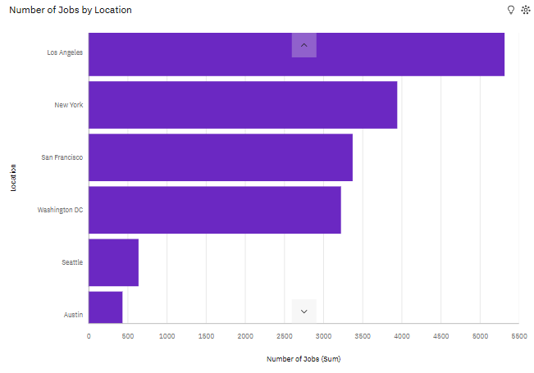
JOB POSTINGS
Job posting data gathered using the Job API

Slide 23
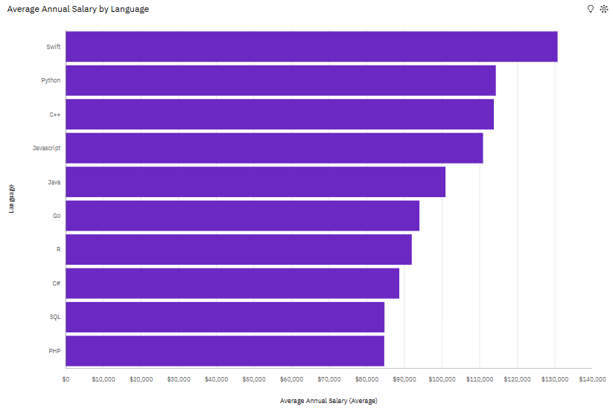
POPULAR LANGUAGES
Job postings data using web scraping presented in the descending order of salary.

